Slide 1
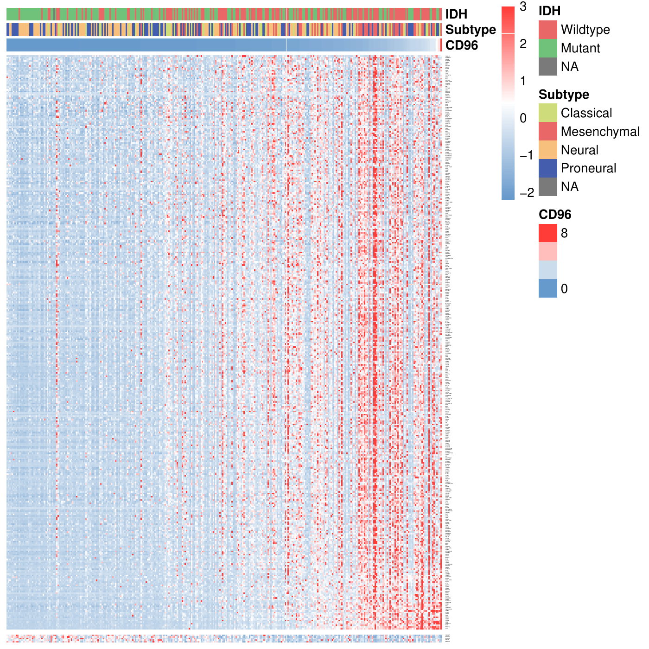
Reproducing Figure 4
CD96-related immune gene heatmap in glioma
English explanation of the heatmap principle, R code workflow, and interpretation
CGGA + TCGA
Spearman correlation
Row z-score heatmap
Prepared from the supplied data files and the published Figure 4 layout.
Notes:
This deck explains how to reproduce Figure 4, the CD96-related immune-response gene heatmap. The key idea is to order samples by CD96 expression, select immune genes correlated with CD96, convert each gene expression profile into a row-wise z-score, and display the standardized matrix as a heatmap with clinical annotations.

Slide 2
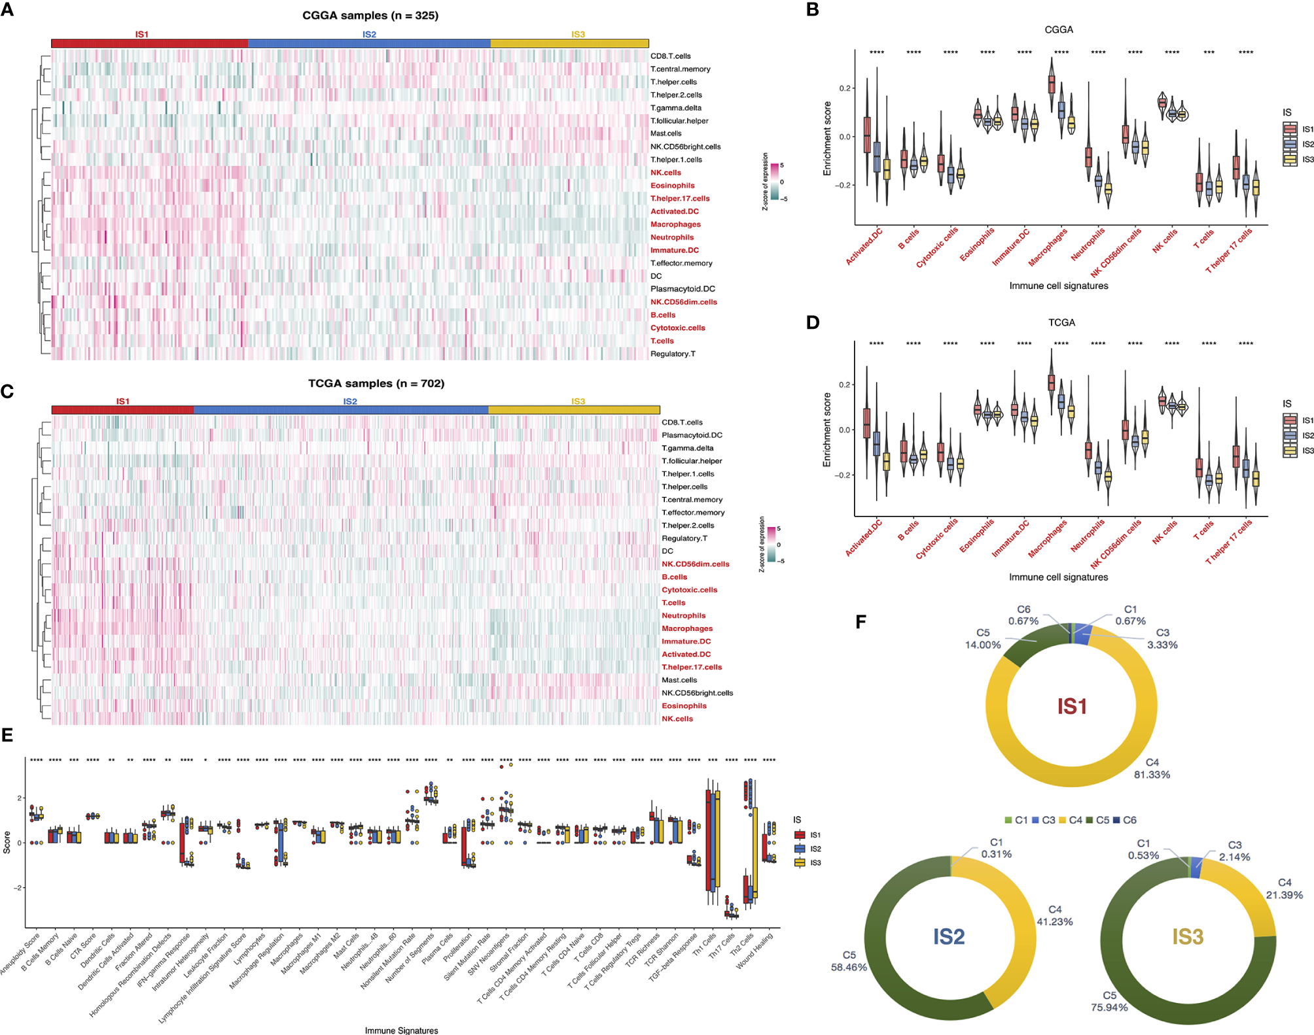
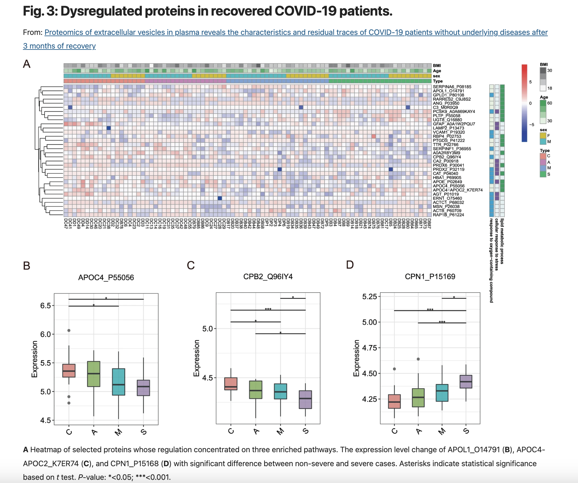
Dissecting tumor antigens and immune subtypes of glioma to develop mRNA vaccine
Proteomics of extracellular vesicles in plasma reveals the characteristics and residual traces of COVID-19 patients without underlying diseases after 3 months of recovery

Slide 3
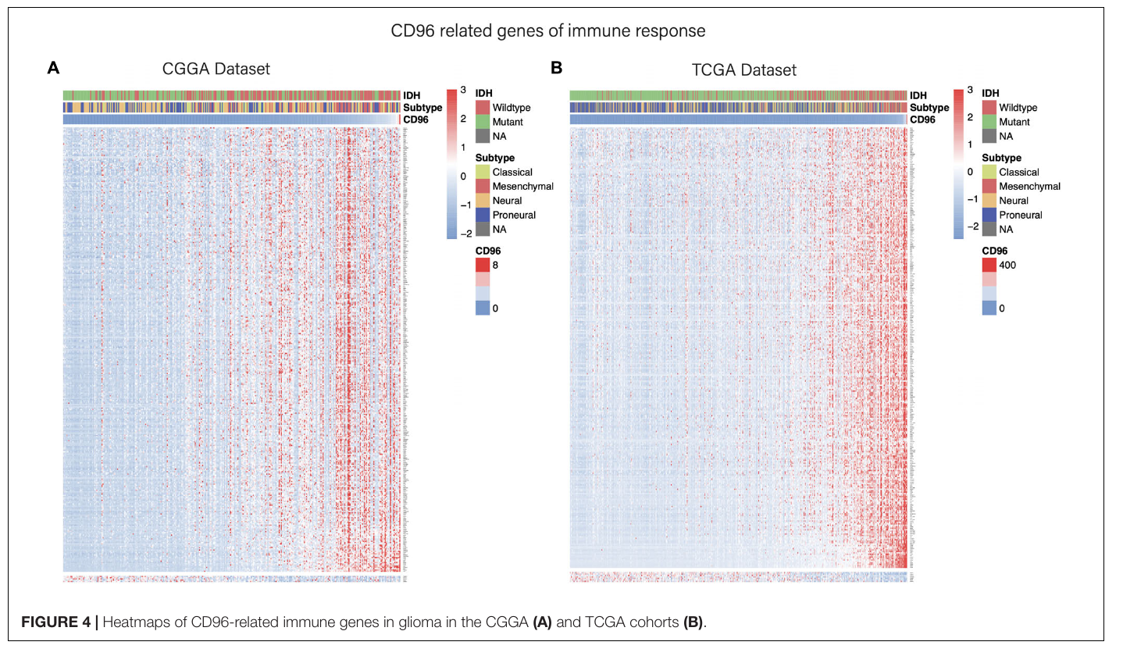
Original target: what Figure 4 shows
The manuscript displays two heatmaps: CGGA on the left and TCGA on the right.
Visual structure
Columns are glioma samples ordered by CD96 expression. Rows are immune-response genes correlated with CD96.
Top annotations
IDH status, molecular subtype, and CD96 expression are shown above the heatmap.
Main pattern
A red gradient toward the high-CD96 side indicates many immune genes increase with CD96.
Source: Zhang et al., Frontiers in Bioengineering and Biotechnology, 2020; Figure 4 from the uploaded PDF.
Figure 4 heatmap reproduction | 2
Notes:
Figure 4 is not a clustered heatmap. The samples are deliberately ordered by CD96 expression from low to high. The rows are genes selected by correlation with CD96. Therefore, the heatmap is designed to show whether immune genes rise together with CD96 rather than to discover unsupervised sample clusters.

Slide 4
Inputs required to rebuild the heatmap
The code uses expression data, clinical annotation, and an immune-response gene list.
1
Expression matrix
Input files used here
CGGA:
easy_input_CGGA.csv
CGGA_CD96.csv
TCGA:
TCGA_533_exp_trans.csv
TCGA_533_clin.csv
Gene list:
easy_input_genes.txt
Genes × samples for CGGA; samples × Entrez genes for TCGA before conversion.
2
Clinical annotation
Sample ID, IDH mutation status, molecular subtype, and optional survival variables.
3
Immune gene list
Candidate immune-response genes are tested for correlation with CD96.
Figure 4 heatmap reproduction | 3
Notes:
The core input is an expression matrix with one numeric expression value for every gene in every sample. The clinical file provides the sample-level labels used as top annotations. The gene list restricts the heatmap to immune-response genes rather than all genes in the transcriptome.

Slide 5
Heatmap principle: from expression to colors
Each cell represents standardized expression of one gene in one sample.
Raw expression matrix
Row-wise z-score
Color mapping
Sample1 Sample2 Sample3
CD68 2.1 3.4 7.8
LCK 0.8 1.2 4.5
PDCD1 0.2 0.3 1.6
For each gene separately:
z = (expression − gene mean) / gene SD
low
mean
high
Why standardize by gene?
Different genes have different expression ranges. Z-scoring makes the color scale comparable across genes.
Why clip at ±3?
Extreme values are capped so a few outliers do not dominate the color scale.
How to read red/blue
Red means higher than that gene’s average; blue means lower than that gene’s average.
Figure 4 heatmap reproduction | 4
Notes:
The heatmap color does not show the raw expression value. It shows how high or low a gene is in a sample relative to that same gene across all samples. This is why row-wise z-scoring is used. Clipping values at minus three and plus three improves readability by reducing the effect of outliers.

Slide 6
Overall workflow
A supervised ordering is used to reveal immune genes that track CD96 expression.
Read data
expression + clinical + gene list
Match samples
keep shared sample IDs
Order columns
low → high CD96
Correlate genes
Spearman rho with CD96
Filter + sort
|rho| > 0.30, p < 0.05
Draw heatmap
z-score, annotations, no clustering
Important design choice
cluster_cols = FALSE and cluster_rows = FALSE. The Figure 4 pattern is produced by deliberate sorting, not unsupervised clustering.
Biological question
Do immune-response genes increase in samples with higher CD96 expression, and does this pattern replicate in CGGA and TCGA?
Figure 4 heatmap reproduction | 5
Notes:
The workflow is intentionally supervised. First, samples are aligned with clinical data. Second, samples are ordered by CD96 expression. Third, each immune gene is tested for monotonic association with CD96 using Spearman correlation. Finally, the selected genes are placed in correlation order and visualized without clustering.

Slide 7
Code block 1: read and align the data
The first step is to make a clean genes × samples matrix and align it with clinical metadata.
# CGGA expression: genes x samples
expr <- read.csv("easy_input_CGGA.csv",
row.names = 1, check.names = FALSE)
expr <- as.matrix(expr)
mode(expr) <- "numeric"
# Clinical annotation
clin <- read.csv("CGGA_CD96.csv", check.names = FALSE)
rownames(clin) <- clin$ID
# Keep only shared samples
common <- intersect(colnames(expr), rownames(clin))
expr <- expr[, common, drop = FALSE]
clin <- clin[common, , drop = FALSE]
What this means
The heatmap can only use samples that have both expression values and clinical annotations. Matching by sample ID prevents annotation shifts.
TCGA special step
The TCGA expression file uses Entrez IDs as gene names. The cleaned script converts Entrez IDs to gene symbols before selecting immune genes.
Why check.names = FALSE?
It keeps original sample IDs and gene names unchanged, avoiding unwanted punctuation conversion by R.
Figure 4 heatmap reproduction | 6
Notes:
The code first reads the expression matrix and clinical table. For CGGA, genes are already in rows and sample IDs are in columns. For TCGA, the cleaned script includes an additional conversion from Entrez IDs to gene symbols. The most important rule is that sample order in the expression matrix and annotation table must be exactly aligned.

Slide 8
Code block 2: order samples by CD96
Columns are sorted from low to high CD96 expression.
# CD96 expression vector
cd96 <- as.numeric(expr["CD96", ])
names(cd96) <- colnames(expr)
# Sample order used in the heatmap
sample_order <- names(sort(cd96, decreasing = FALSE))
# Immune gene matrix, columns sorted by CD96
gene_list <- read.table("easy_input_genes.txt",
header = TRUE, sep = "\t")[[1]]
immune_genes <- intersect(rownames(expr), gene_list)
immune_expr <- expr[immune_genes, sample_order, drop = FALSE]
Low CD96
High CD96
Interpretation
When genes are positively correlated with CD96, their expression tends to become redder toward the right side of the heatmap.
Figure 4 heatmap reproduction | 7
Notes:
This step creates the column order. The samples are not clustered. Instead, they are arranged by the expression of one marker, CD96. A gene that follows CD96 will therefore tend to show blue colors at the left and red colors at the right.

Slide 9
Code block 3: identify CD96-related immune genes
Spearman correlation captures monotonic association without assuming linearity.
cor_res <- do.call(rbind, lapply(rownames(immune_expr), function(gene) {
test <- cor.test(as.numeric(immune_expr[gene, ]),
as.numeric(cd96[sample_order]),
method = "spearman", exact = FALSE)
data.frame(gene = gene,
rho = unname(test$estimate),
p = test$p.value)
}))
pos_genes <- cor_res[cor_res$rho > 0.30 & cor_res$p < 0.05, ]
neg_genes <- cor_res[cor_res$rho < -0.30 & cor_res$p < 0.05, ]
rho > 0
The gene tends to increase when CD96 increases.
rho < 0
The gene tends to decrease when CD96 increases.
Cutoff used
The manuscript logic uses |rho| > 0.30 and p < 0.05 to define CD96-related immune genes for the heatmap.
Why Spearman?
It ranks samples and is robust to non-normal expression distributions.
Figure 4 heatmap reproduction | 8
Notes:
For each immune gene, the code calculates Spearman correlation between that gene expression vector and the CD96 expression vector across the same ordered samples. Positive rho means the gene tends to increase with CD96. Negative rho means it tends to decrease. The selected genes form the heatmap rows.

Slide 10
Code block 4: scale, annotate, and draw
The final pheatmap call recreates the manuscript-style heatmap.
# Row order: weaker-to-stronger positive genes, then negative genes
pos_genes <- pos_genes[order(pos_genes$rho), ]
neg_genes <- neg_genes[order(neg_genes$rho), ]
plot_genes <- c(pos_genes$gene, neg_genes$gene)
# Row-wise z-score and clipping
mat <- immune_expr[plot_genes, sample_order, drop = FALSE]
z <- t(scale(t(mat)))
z[is.na(z)] <- 0
z[z > 3] <- 3; z[z < -3] <- -3
pheatmap(z, scale = "none", cluster_cols = FALSE,
cluster_rows = FALSE, show_colnames = FALSE,
annotation_col = ann_col, annotation_colors = ann_colors,
color = colorRampPalette(c("#6699CC", "white", "#FF3C38"))(128))
cluster_cols = FALSE
Keeps samples in the CD96-defined order.
cluster_rows = FALSE
Keeps genes in correlation-defined order.
annotation_col
Adds IDH, subtype, and CD96 tracks above the heatmap.
gaps_row
Separates positive and negative correlation blocks, if negative genes exist.
Figure 4 heatmap reproduction | 9
Notes:
The scaling is done manually before pheatmap, so the pheatmap scale option is set to none. Clustering is turned off because the ordered display is the point of this figure. The annotation color list ensures that IDH status, subtype, and CD96 expression have stable colors.

Slide 11
Reproduced output: CGGA cohort
The CGGA heatmap shows immune genes increasing across the CD96 gradient.
How to read this
The right side contains high-CD96 samples. Red regions on the right indicate immune-response genes with higher standardized expression in high-CD96 tumors.
Top tracks
The annotation bars show how IDH status and molecular subtype distribute along the CD96 expression axis.
Main takeaway
A broad positive immune-expression pattern supports the statement that CD96 is associated with immune-response activity in glioma.
Figure 4 heatmap reproduction | 10
Notes:
In the reproduced CGGA heatmap, samples move from low CD96 to high CD96 from left to right. The main visual signal is an increase in red values toward the high-CD96 end, meaning many CD96-related immune genes are more highly expressed in those samples.

Slide 12
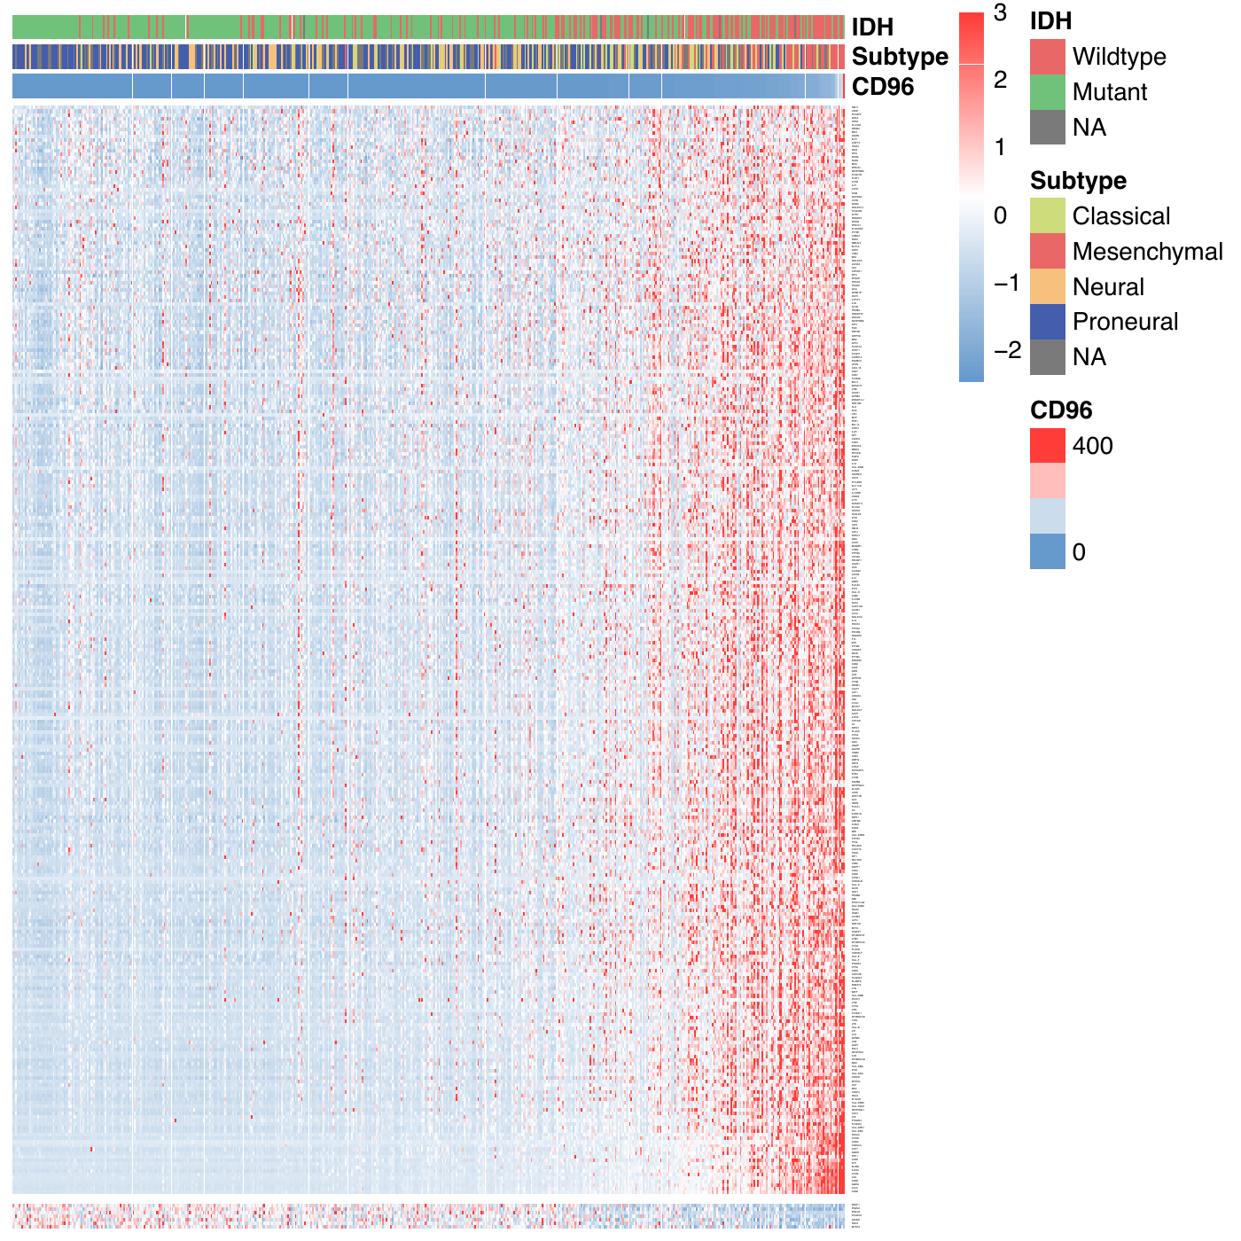
Reproduced output: TCGA cohort
The same supervised heatmap structure can be applied to TCGA for validation.
Validation logic
Repeating the same algorithm in TCGA checks whether the CD96-associated immune pattern is consistent across cohorts.
Expression ID issue
The TCGA file uses Entrez IDs, so the cleaned script maps Entrez IDs to gene symbols before selecting CD96 and immune genes.
Interpretation
A similar right-side red shift indicates that immune genes are also positively related to CD96 in the TCGA cohort.
Figure 4 heatmap reproduction | 11
Notes:
The TCGA version uses the same logic as CGGA. One additional preprocessing step is necessary because the TCGA expression matrix uses Entrez identifiers. After conversion to symbols, CD96 and immune genes can be selected in the same way. The similar pattern supports cohort-level reproducibility.

Slide 13
Heatmap clustering principle
A clustered heatmap combines color-coded values with similarity-based reordering.
1. Calculate similarity
Rows or columns with similar expression patterns should be close together. Common choices: Euclidean distance, Pearson/correlation distance, or Spearman/rank distance.
2. Build dendrogram
Hierarchical clustering repeatedly joins the most similar rows/columns. The tree height reflects dissimilarity.
Original matrix
Key idea
Clustering changes the row/column order so related genes or samples form visible blocks.
Reordered matrix
Sources: Eisen et al., 1998; Wilkinson & Friendly, 2009; pheatmap documentation.
Figure 4 heatmap reproduction | 12
Notes:
A heatmap becomes a clustered heatmap when rows and columns are reordered according to similarity. First, we define a distance between expression profiles. Second, hierarchical clustering builds a tree. Third, the heatmap is redrawn in tree order so that similar genes or samples appear next to each other. This makes hidden block patterns easier to see.

Slide 14
Clustering methods: what changes the result?
Different distance and linkage choices can produce different dendrograms.
Distance metric
Defines how “similar” two rows or columns are.
Linkage rule
Defines how two clusters are merged after pairwise distances are computed.
# pheatmap examples
pheatmap(mat,
clustering_distance_rows = "correlation",
clustering_method = "complete")
# Turn clustering off for a supervised order
pheatmap(mat,
cluster_rows = FALSE,
cluster_cols = FALSE)
Euclidean distance
Complete linkage
Groups by absolute expression differences.
Uses the farthest pair; tends to make compact clusters.
Correlation distance
Average linkage
Groups by shared pattern, even when amplitude differs.
Uses the average pairwise distance; often stable for expression data.
Spearman distance
Ward linkage
Groups by rank-based monotonic pattern.
Merges clusters to minimize within-cluster variance.
Source: pheatmap documentation describes clustered heatmaps and clustering controls.
Figure 4 heatmap reproduction | 13
Notes:
Clustering is not one fixed method. The distance metric determines how similarity is measured. Linkage determines how groups are merged into a tree. For expression data, correlation distance is often useful because we care about shared up-and-down patterns. In the CD96 Figure 4 reproduction, however, clustering is intentionally turned off because the order is defined by CD96 expression and by correlation with CD96.

Slide 15
Supervised ordering vs. unsupervised clustering
Figure 4 uses supervised ordering, but clustered heatmaps answer a different question.
Supervised heatmap
Unsupervised clustered heatmap
Samples ordered by CD96 →
Samples grouped by similarity
Best for
Testing whether a predefined variable, such as CD96, grade, treatment, or risk score, explains gene-expression patterns.
Best for
Discovering unknown sample subtypes, gene modules, or co-expression blocks when no ordering variable is imposed.
For this CD96 figure
Use supervised ordering because the biological question is: do immune genes increase as CD96 increases?
Figure 4 heatmap reproduction | 14
Notes:
This slide separates two ideas that are often confused. A clustered heatmap is exploratory: it lets the data decide the row and column order. A supervised heatmap is hypothesis-driven: it orders samples by a variable such as CD96 and then asks whether genes follow that variable. Figure 4 is best interpreted as a supervised heatmap, not as a discovery of unsupervised clusters.

Slide 16
Heatmaps are widely used in similar omics studies
They compress high-dimensional molecular data into interpretable patterns.
Gene signatures
Tumor subtyping
DE genes across tumor groups or treatment response.
Patient clusters and subtype annotations.
Immune programs
Single-cell markers
Checkpoint genes, infiltration scores, cytokines, or GO modules.
Marker genes across cell clusters or states.
Why useful
Rows can be genes, pathways, proteins, methylation sites, or cell states. Columns can be patients, samples, cells, spatial spots, or conditions.
Why common in papers
A heatmap can show expression magnitude, clustering structure, and clinical/sample annotations in one figure.
Examples/sources: Eisen et al., 1998; Gu et al., 2016; Seurat DoHeatmap documentation; Zhang et al., 2020 Figure 4.
Figure 4 heatmap reproduction | 15
Notes:
Heatmaps are used broadly because omics data are naturally matrix-shaped. In bulk RNA-seq, heatmaps show differential gene signatures or tumor subtypes. In immuno-oncology, they show checkpoint genes, immune infiltration scores, and pathway activity. In single-cell analysis, heatmaps show marker genes across clusters. In multi-omics, rows may be pathways, proteins, methylation sites, or model scores.

Slide 17
How to explain Figure 4 in one minute
Use this short narration when presenting the heatmap.
Step 1
Samples are ordered from low to high CD96 expression, so the horizontal axis is a CD96 gradient.
Step 2
Rows are immune-response genes whose expression is significantly correlated with CD96.
Step 3
Each color is a row-wise z-score: red means higher-than-average expression for that gene; blue means lower.
Conclusion
The red shift toward high-CD96 samples indicates that CD96 is associated with broad immune-response gene activity in both cohorts.
This interpretation follows the CD96 glioma article: CD96-related immune genes were visualized in CGGA and TCGA heatmaps.
Figure 4 heatmap reproduction | 16
Notes:
A concise explanation is: We ordered glioma samples by CD96 expression, selected immune-response genes that correlate with CD96, standardized each gene across samples, and plotted the matrix as a heatmap. Red on the high-CD96 side means immune genes are more active in CD96-high tumors. Seeing the same pattern in CGGA and TCGA supports that this is not cohort-specific.

Slide 18
Deliverables and practical checks
Use the cleaned R script as the reproducible starting point.
Clean script
Checklist before running
reproduce_figure4_cd96_heatmap.R
Outputs:
CGGA_correlationHeatmap_reproduced.pdf
TCGA_correlationHeatmap_reproduced.pdf
CGGA_CD96_correlations.csv
TCGA_CD96_correlations.csv
Confirm sample IDs match between expression and clinical files.
Confirm CD96 is present after gene ID conversion.
Confirm the immune gene list uses gene symbols.
Keep clustering off if reproducing Figure 4.
Use row z-scores, not raw expression values, for colors.
One-sentence summary
Figure 4 is a supervised correlation heatmap showing that immune-response genes tend to increase across samples ordered from low to high CD96 expression.
Common troubleshooting
If the plot has too few genes, check gene identifiers and lower the rho cutoff only after confirming the input data are correctly matched.
Figure 4 heatmap reproduction | 17
Notes:
The accompanying R script consolidates the reproduction workflow into reusable functions for CGGA and TCGA. The most common reasons for reproduction failure are mismatched sample IDs, gene symbols not matching the expression matrix, missing CD96 after identifier conversion, and accidental clustering that changes the intended row or column order.

